Slide 1
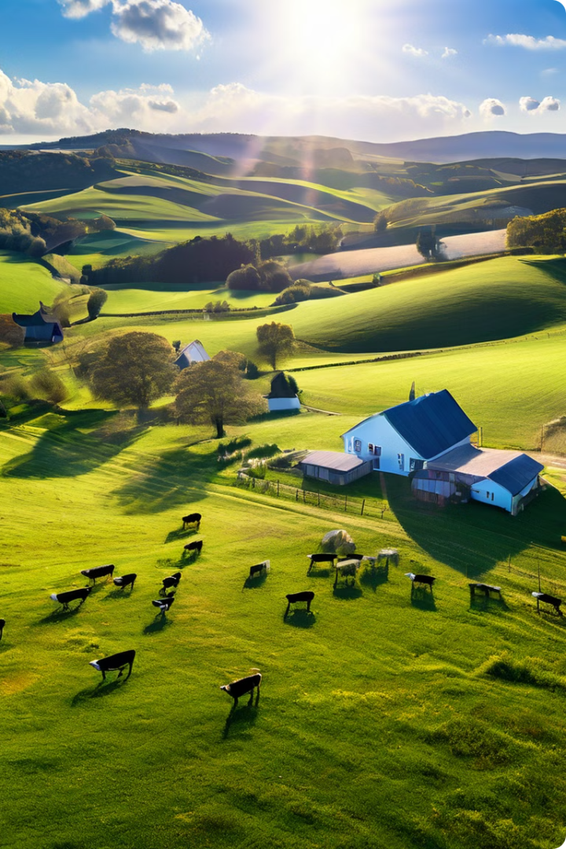
DairyLink: Empowering Dairy Farmers
Welcome to DairyLink, a comprehensive online platform designed to streamline operations and enhance productivity for dairy farmers and cooperatives.

Slide 2
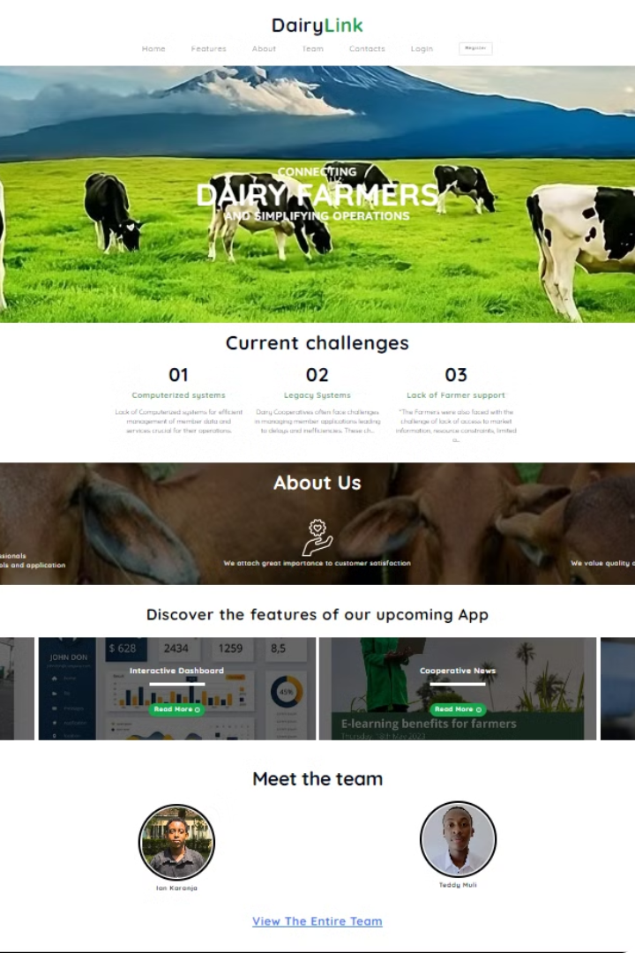
Overview of DairyLink's Features
1
Centralized Hub
2
Personalized Experience
DairyLink acts as a central hub for all your dairy-related information, connecting farmers, cooperatives, and industry stakeholders.
DairyLink provides a tailored experience based on individual user preferences and roles, making it easy to find relevant information and services.
3
Streamlined Processes
4
Data-Driven Insights
DairyLink simplifies and automates various dairy farm operations, reducing administrative burden and improving efficiency.
DairyLink leverages data analytics to provide valuable insights into farm performance, allowing farmers to make informed decisions.

Slide 3

Personal Profile Management
Profile Creation
Account Security
Notifications and Alerts
Farmers can easily create and manage their personal profiles, updating their contact information, farm details, and other relevant data.
DairyLink prioritizes data security with robust authentication measures and secure storage protocols to protect sensitive information.
Stay informed with real-time notifications and alerts regarding important updates, messages, or actions requiring your attention.

Slide 4
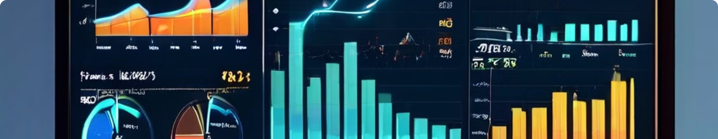
Reporting and Analytics
Production Monitoring
Financial Analysis
Comparative Benchmarking
Track milk production, herd health, and other essential metrics to gain a comprehensive understanding of farm performance.
Analyze financial records, identify trends, and optimize financial management strategies for greater profitability.
Compare your farm's performance to industry benchmarks and identify areas for improvement based on data-driven insights.

Slide 5




Loan Services
Application Submission
Farmers can easily apply for loans through a user-friendly online application process with clear instructions and requirements.
Review and Approval
Loan applications are reviewed by experienced professionals who assess creditworthiness and evaluate loan eligibility.
Disbursement and Repayment
Approved loans are disbursed promptly, and convenient online repayment options are available to ensure seamless financial management.

Slide 6
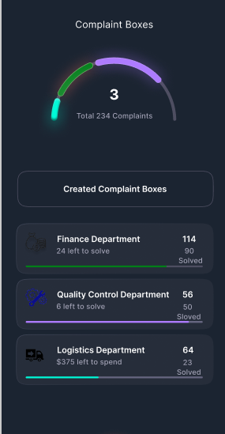
Complaint Lodging
Issue Reporting
Farmers can report any issues or concerns they may have with DairyLink, cooperatives, or other stakeholders.
Evidence Submission
Upload relevant documents or evidence to support your complaint and provide a comprehensive account of the situation.
Resolution Tracking
Monitor the status of your complaint, receive updates, and engage with DairyLink's support team for timely resolution.

Slide 7
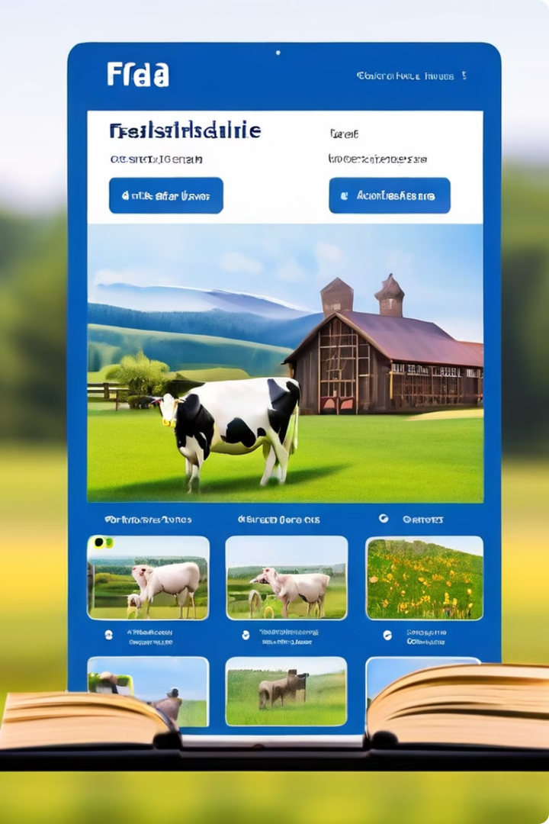



E-Learning Materials
Dairy Farming Essentials
Access comprehensive courses and guides covering core aspects of dairy farming, from animal care and milk production to financial management and marketing.
Industry Updates and Trends
Stay informed about the latest industry advancements, market trends, and regulatory updates through webinars and video tutorials.
Skill Development and Certifications
Enhance your expertise with specialized courses and earn industry-recognized certifications to boost your career prospects and knowledge base.

Slide 8

Collaboration and Communication Tools
1
Online Forums
Connect with fellow dairy farmers, share insights, ask questions, and engage in discussions on relevant topics within the DairyLink community.
2
Messaging and Chat
Communicate directly with other farmers, cooperatives, or DairyLink staff through secure messaging and chat features.
3
Resource Sharing
Share relevant documents, reports, or data with other users to facilitate knowledge sharing and collaboration within the DairyLink ecosystem.

Slide 9



Data Security and Privacy
Data Encryption
Access Control
Privacy Compliance
DairyLink uses advanced encryption techniques to protect sensitive data, ensuring confidentiality and integrity.
Access to personal information and sensitive data is strictly controlled through user authentication and authorization protocols.
DairyLink adheres to industry-standard privacy regulations and policies to protect your personal information and ensure its responsible use.

Slide 10


Conclusion and Next Steps
DairyLink empowers dairy farmers with a suite of digital tools and services to improve efficiency, profitability, and decision-making. To learn more about DairyLink's features and how it can benefit your dairy farm, contact our dedicated support team today.

